Slide 1
Introduction
Project Objectives: The program should allow customers to login to: 1.Book the car of their choice 2.Edit and delete the car details entered 3.Display the rental cost 4.Confirm/save the booking info into the data storage(vector)
The program should allow staff to login to: 1.Add the car models and their rental prices 2.Edit and delete the car details and rental prices entered 3.Confirm/save the created car details and rental prices in the data storage (vector) 4.View the booking summary and details of the individual booking 5.Calculate the total rental amount earned($)
In this project, our group used three external libraries: (these libraries are zipped with the project submission too)
XML
JDatePicker
JFreeChart

Slide 2
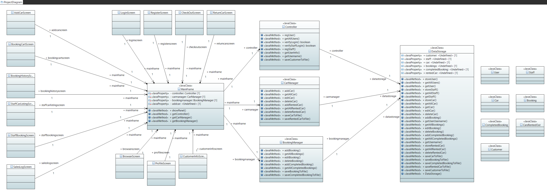
Final Class Diagram
Amount of MVCs in our project:
Model – 8 Classes
View – 13 Classes
Controller – 4 classes

Slide 3
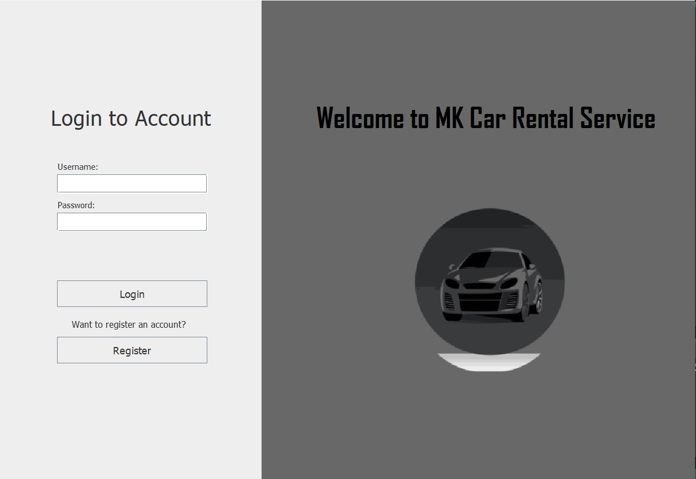
User/Staff can input username & password
Our App name and logo
Once the info is filled, users can click login, if not a warning will be showed
New users can register here​

Slide 4
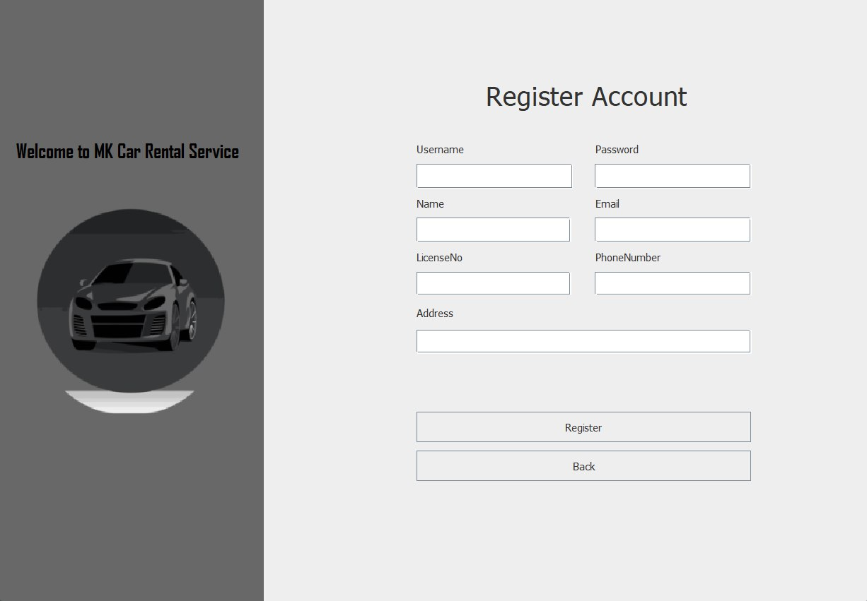
User info must be filled to create an account
An account will be created when press, after customer has key in their info
Back to login page

Slide 5
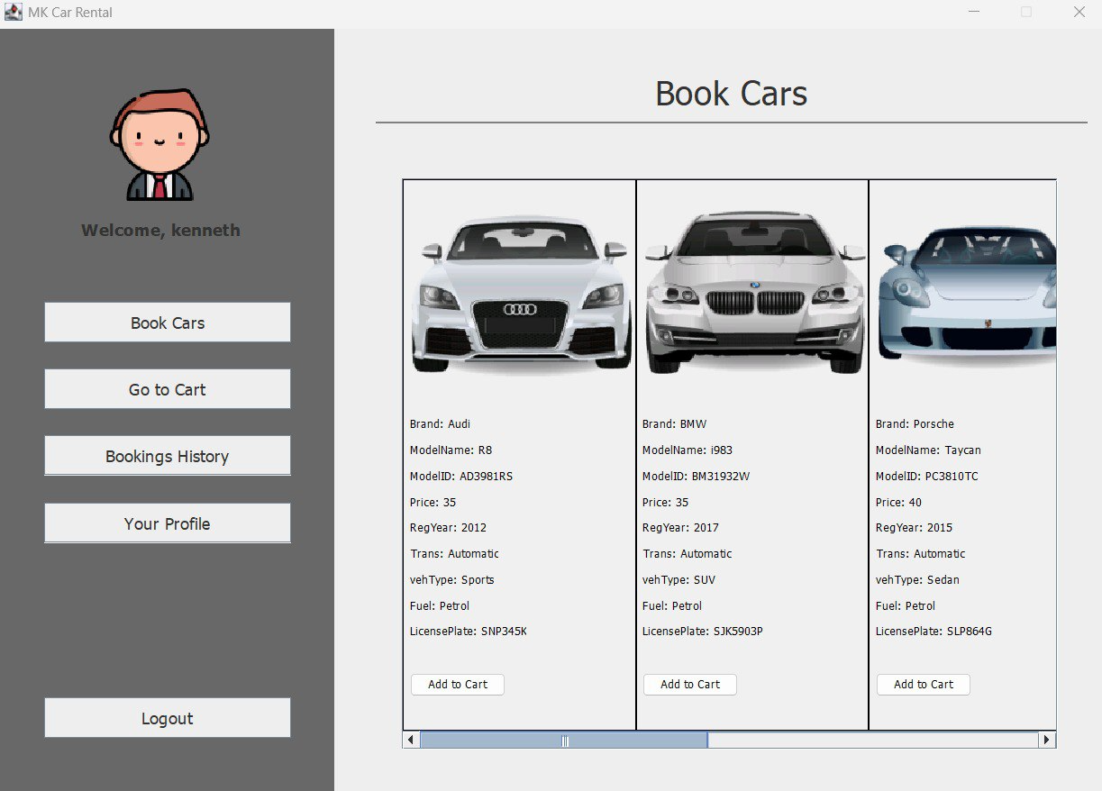
Customer Menu Screen
Cars image will be displayed
The customer’s username displayed
Customers can view other screens by click these buttons
Cars details and price per day will be shown
Customers can logout by clicking on the logout button
Customers can add chosen car to cart by clicking this
Customers can drag the bar too see all available cars

Slide 6
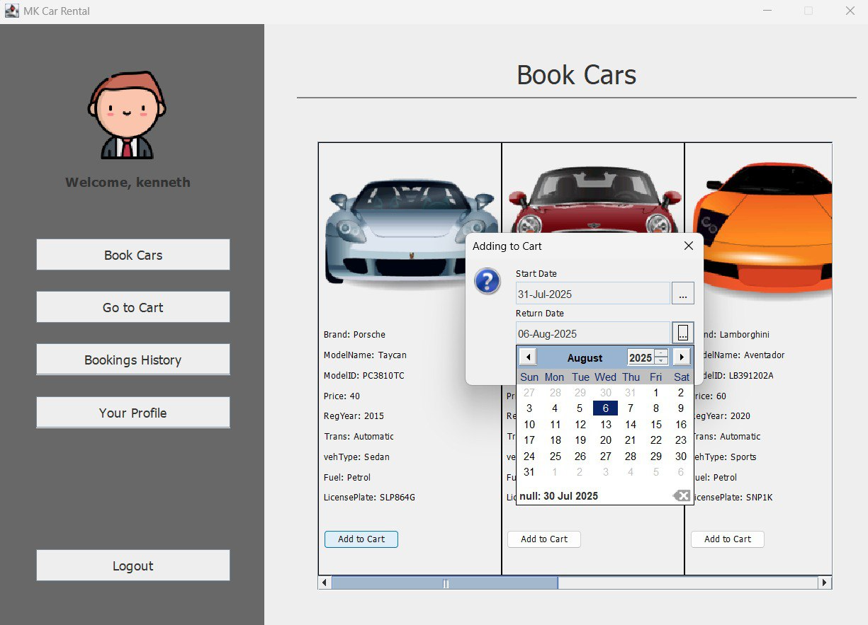
Customer Adding Car
Customers can choose desired start and return date of rental car when pressed on the Add to Cart button

Slide 7
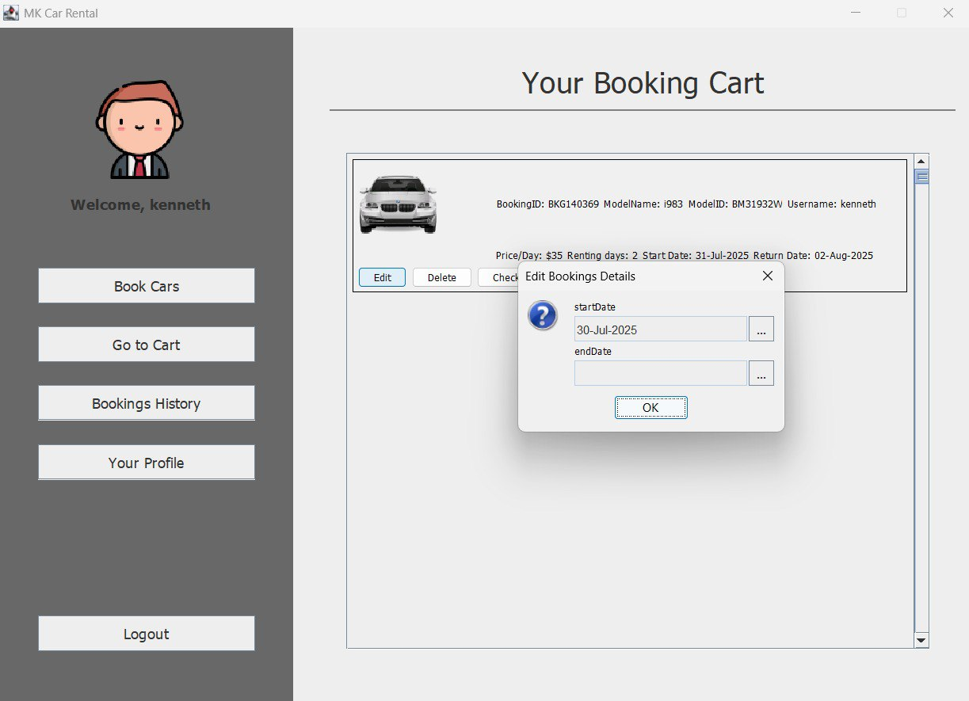
Customer Cart (Edit)
Pop up to edit rental date when customer clicked on edit
Customers can choose to edit, delete or checkout the cars in their booking cart

Slide 8
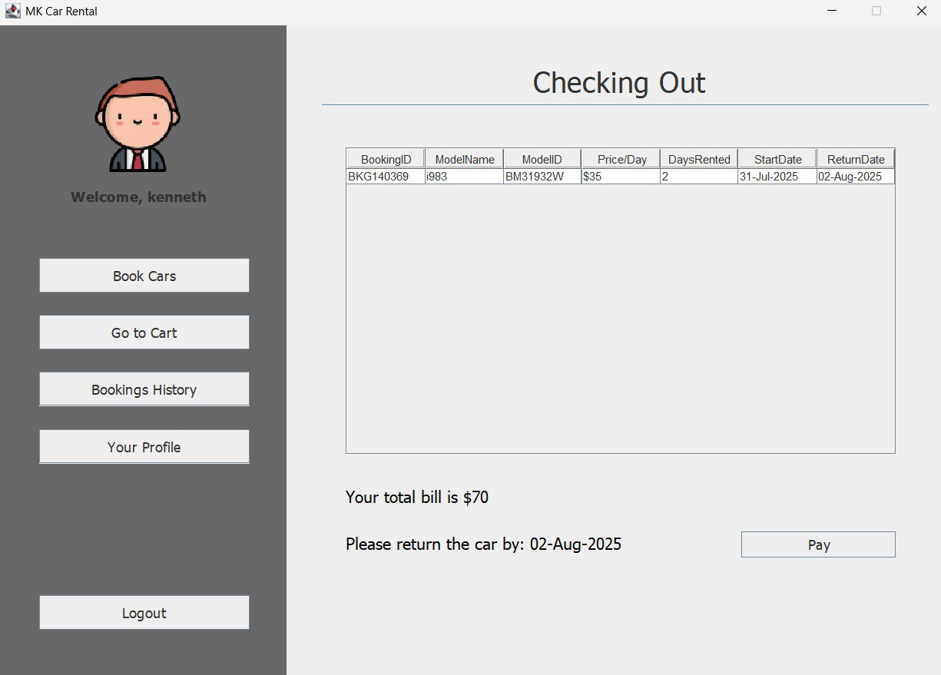
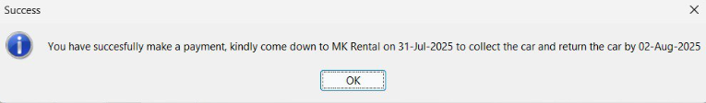
Customer Cart (Check-out & Payment)
Clicking on check out will bring user to checking out page
Rental details of selected car to be shown
Total cost of rental will be calculated
A pop up notify user of payment and return date of car

Slide 9
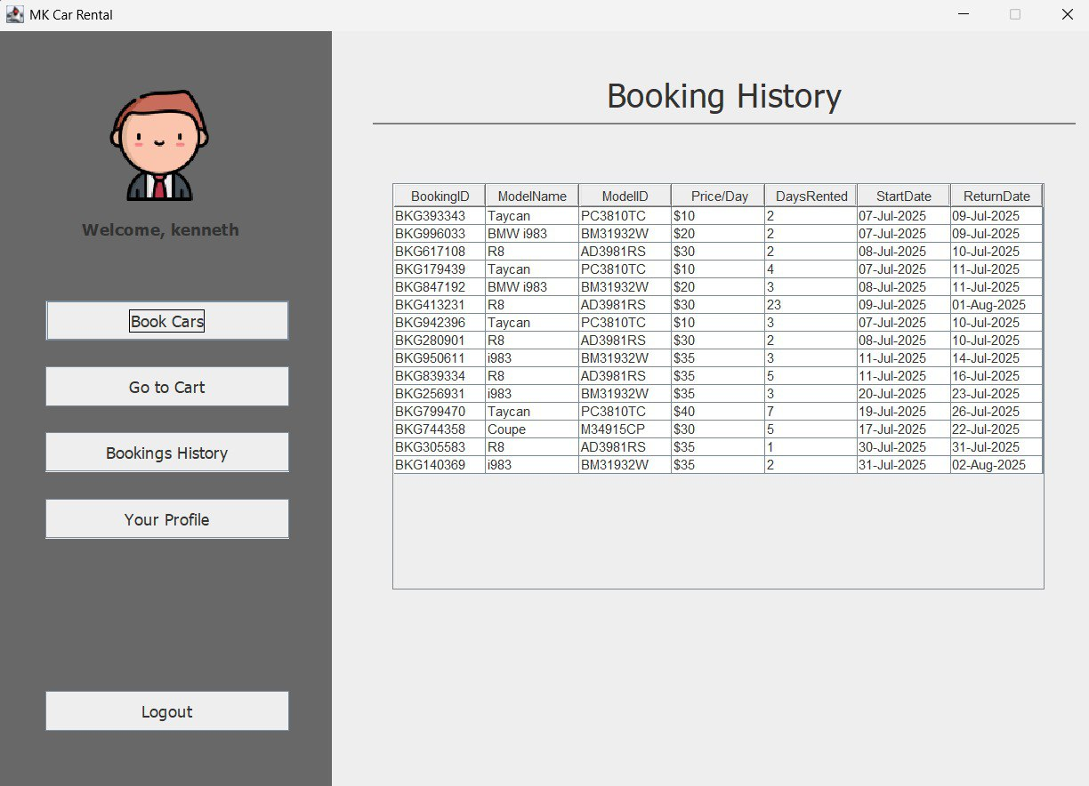
Customer Booking History Screen
Customers can view their pass and current booking history to check return dates

Slide 10
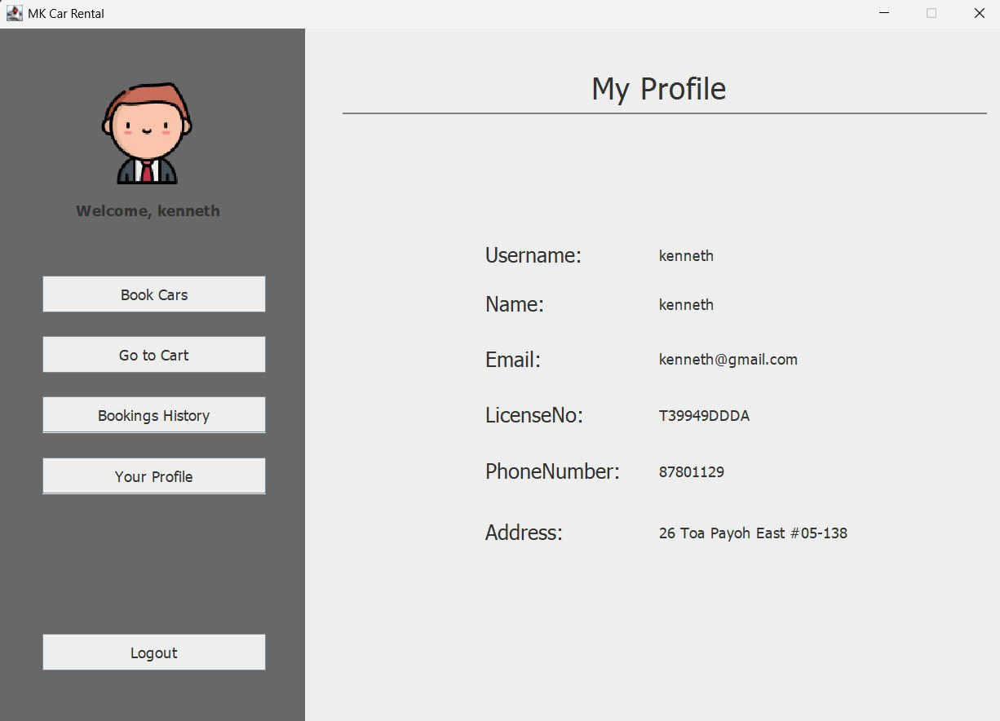
Customer Profile Screen
Customers can view their user details

Slide 11
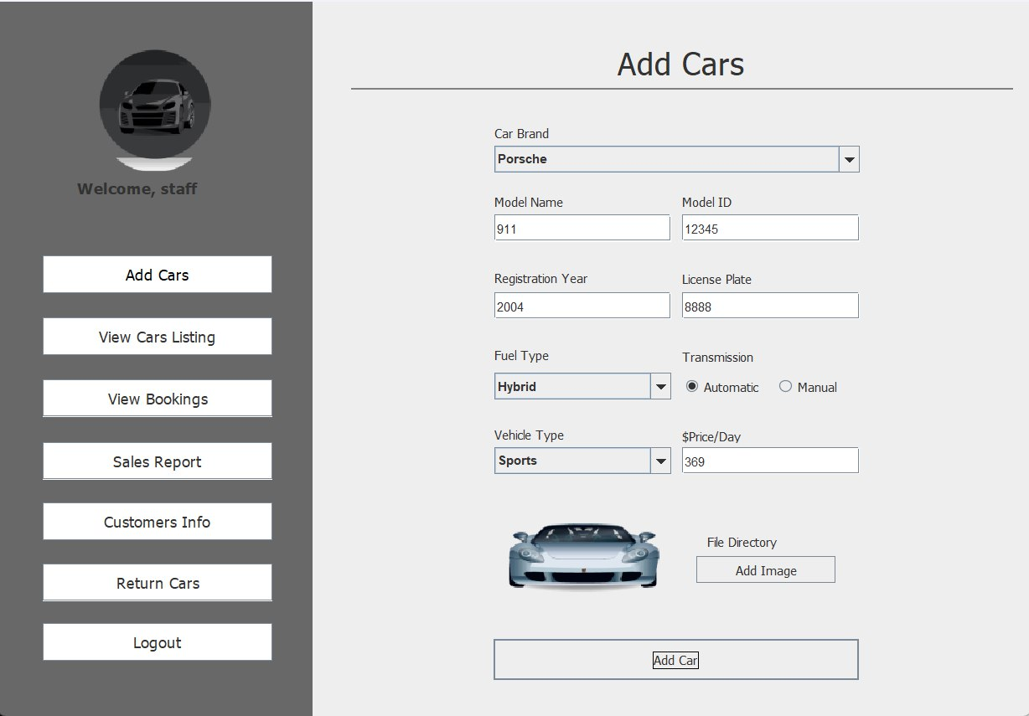
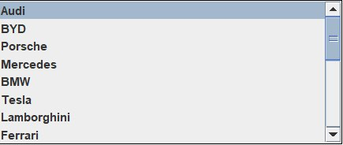
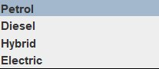
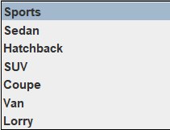
Staff Add Car Screen
Details to be manually filled
Dropdown with all car brands will be shown upon clicking
Dropdown with fuel types will be shown upon clicking
Price of rental to be filled in
Adding image from file is available by clicking the button
Dropdown with vehicle type will be shown upon clicking
Click to add car after all info has been filled

Slide 12
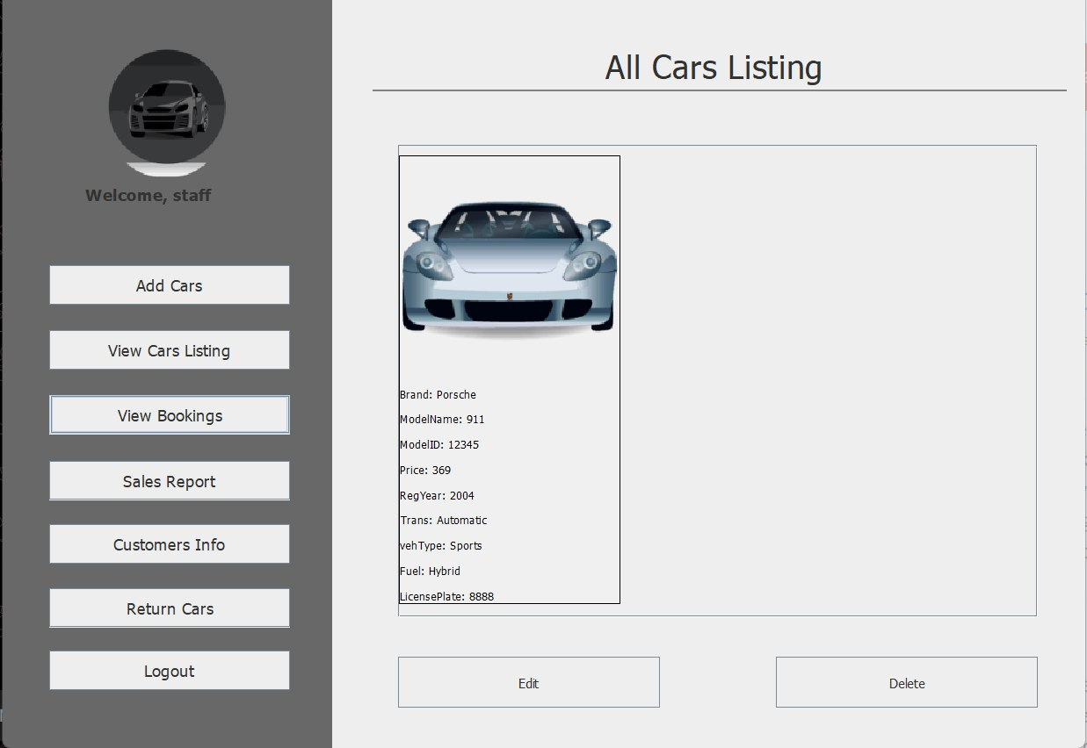
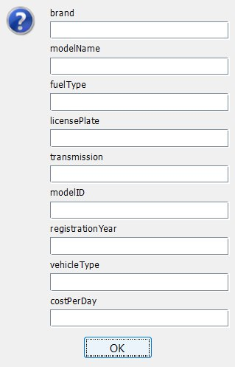
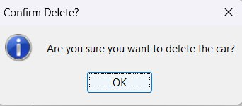
Staff Car listing Screen
Staff can view all previously Added Cars in this screen
Staff can delete existing cars with the delete button
Staff can edit car details by clicking the edit button

Slide 13
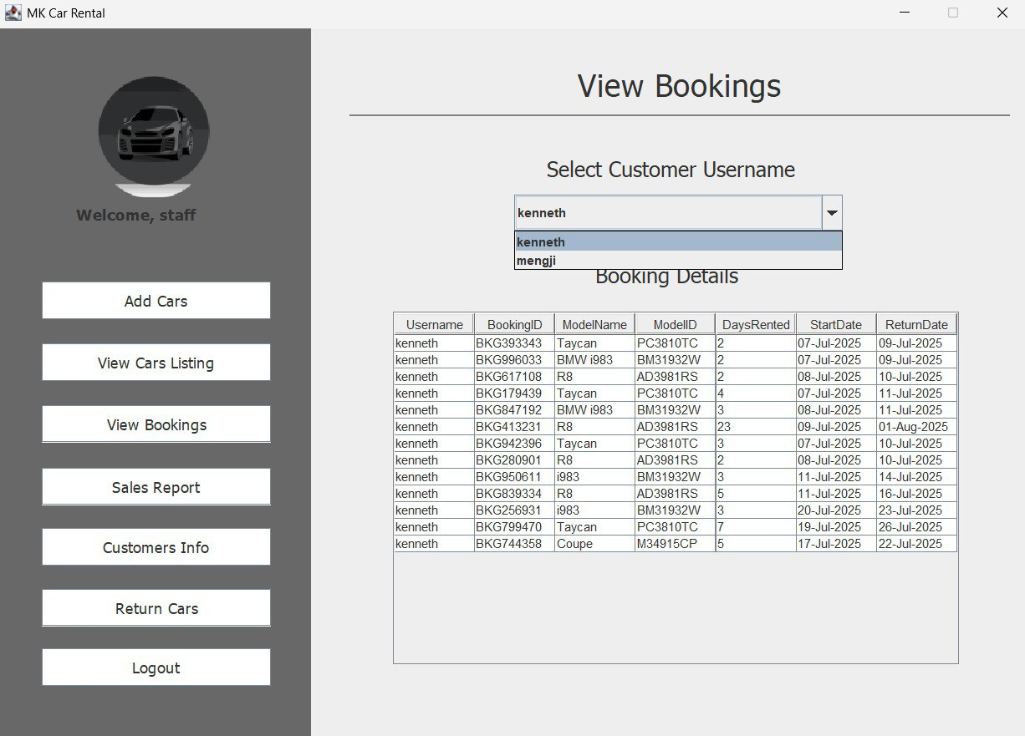
Staff View Booking Screen
Staff Choose the customer to view their booking history
Customer booking info

Slide 14
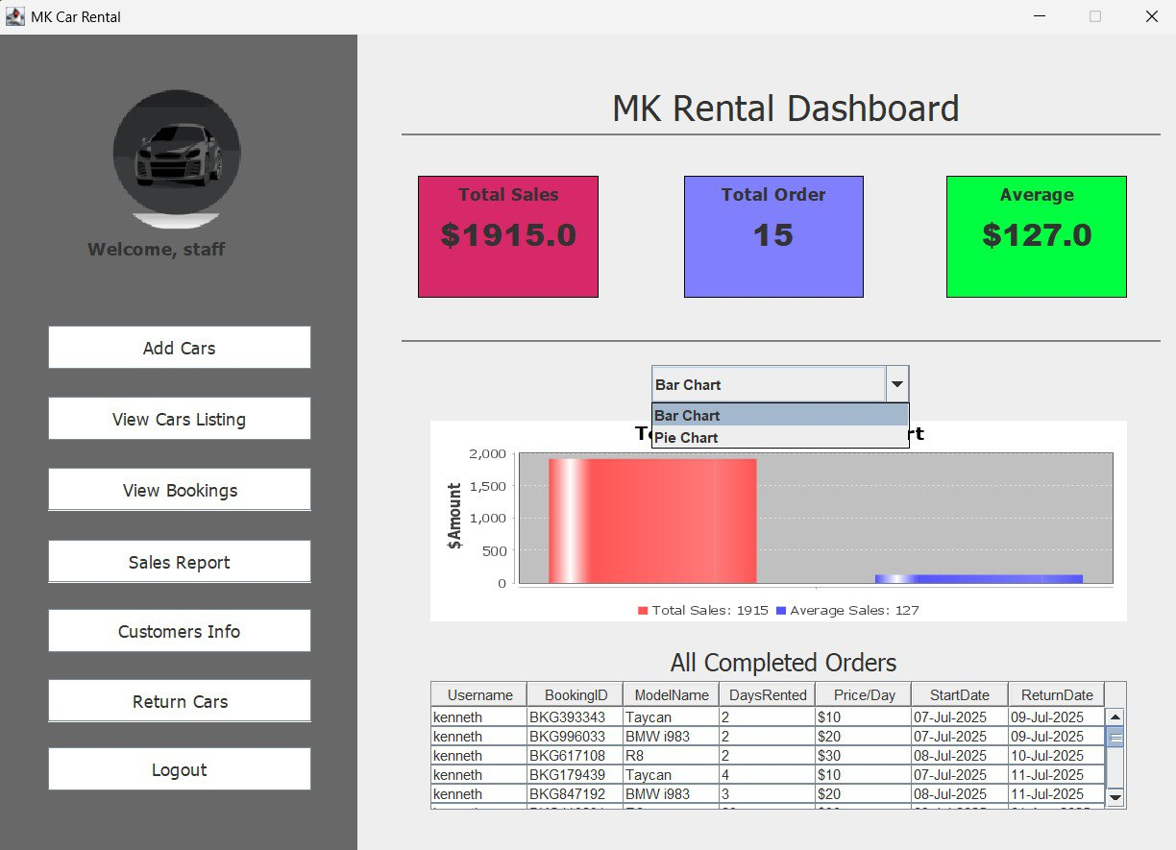
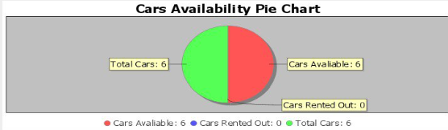
Sales Report Screen
Staff can view total sales, total order and average of total sales in this screen
Staff can choose between bar chart and pie chart to view sales record
Bar chart showing total sales and average sales
Above is the graph when user choose pie chart
Table with scroll bar showing details of completed orders

Slide 15
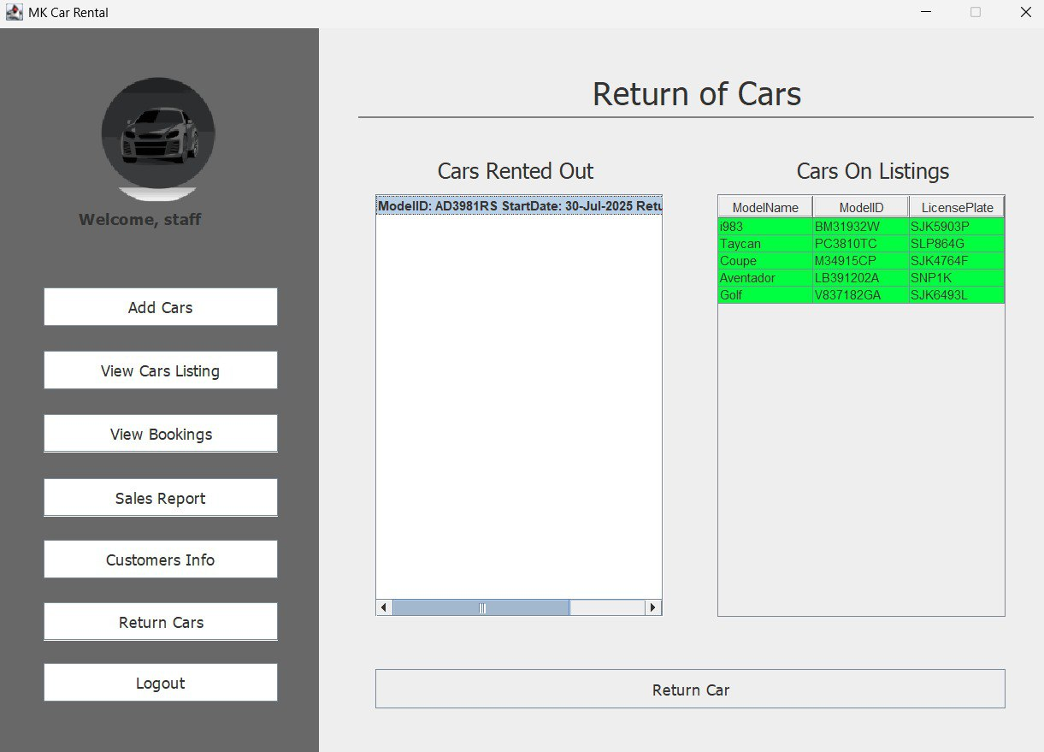
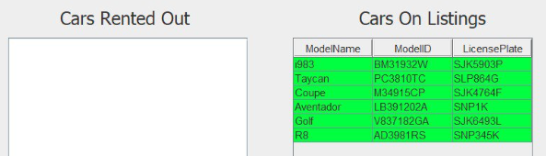
Return Cars Screen
Staff can return the car in the system by clicking on the cars rented out then return cars, to return the back to car on listing
After staff had return the car

